Slide 1

N
Professional
Traverse and
Level Adjustment Software
Precision in every point
USER MANUAL · STEP BY STEP WITH SCREENSHOTS
Version 2.0 · October 2026 · SurveyX Digital
Notes:
Professional Traverse and Level Adjustment Software. User manual, step by step with screenshots.

Slide 2
Contents
THE RED NUMBERS ON EACH SCREENSHOT MATCH THE NUMBERED POINTS
1
Getting started
Open the website, find your way around the top bar and choose light or dark mode.
7
Sharing
Share a job with a checker, engineer or client. They see it in their own dashboard.
2
Your account
Register once on the website. After your first login the app also works without internet on that device.
8
Offline, dark mode and phone
Keep working without internet, at night, or on site from your phone.
3
Dashboard
Your home page: every traverse and level run you save is kept here.
9
Sample files
Ready-made data to practise with.
4
Coordinate traverse
Enter the coordinates measured on site, close on a known point, choose the method and read the result.
10
Troubleshooting
Messages you may see and what to do.
5
Levelling
Reduce a level book by Rise & Fall or Height of Instrument, check it and adjust it.
A
Going live
For the administrator: accounts, website, desktop program.
6
Traverse simulator
Watch a total station observe a traverse with realistic errors, then adjust it. Ideal for training new surveyors.

Slide 3
Getting started
01
Open the website, find your way around the top bar and choose light or dark mode.

Slide 4
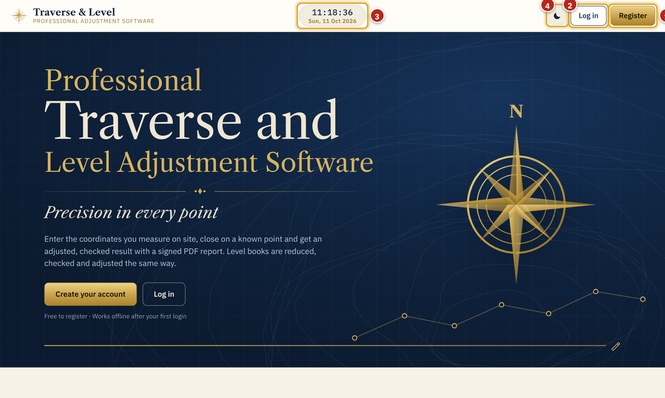
Open the website
1.1 · GETTING STARTED
Open your website address in Chrome, Edge, Safari or Firefox. The front page shows what the software does.
1
Register: create your account (first time only).
2
Log in: if you already have an account.
3
Clock and date: always shown at the top centre. Click it to open the calendar.
4
Light / dark mode: click to switch. Your choice is remembered.
Tip. You can also use the Windows program (.exe). It opens the same app in its own window.
Notes:
Open the website
Open your website address in Chrome, Edge, Safari or Firefox. The front page shows what the software does.
1. Register: create your account (first time only).
2. Log in: if you already have an account.
3. Clock and date: always shown at the top centre. Click it to open the calendar.
4. Light / dark mode: click to switch. Your choice is remembered.
Tip: You can also use the Windows program (.exe). It opens the same app in its own window.

Slide 5
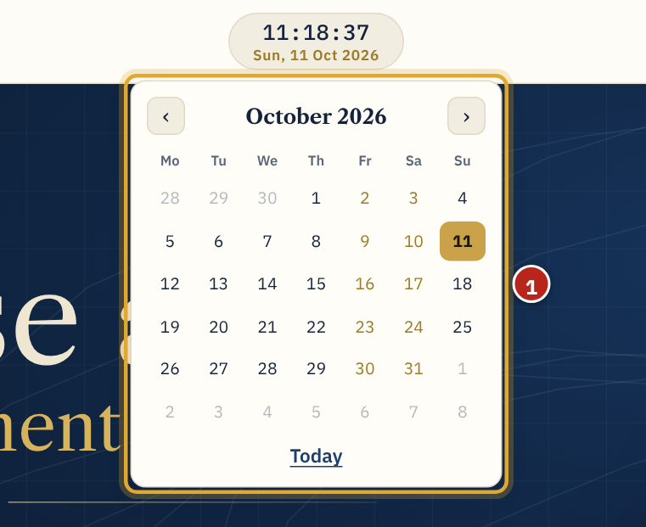
Clock and calendar
1.2 · GETTING STARTED
The live clock and today's date sit at the top centre of every page.
1
Click the clock to open the month calendar. Today is marked in gold; Friday and Saturday are shown in gold. Use ‹ › to change month and Today to come back. Click anywhere else to close it.
Notes:
Clock and calendar
The live clock and today's date sit at the top centre of every page.
1. Click the clock to open the month calendar. Today is marked in gold; Friday and Saturday are shown in gold. Use ‹ › to change month and Today to come back. Click anywhere else to close it.

Slide 6
Your account
02
Register once on the website. After your first login the app also works without internet on that device.

Slide 7
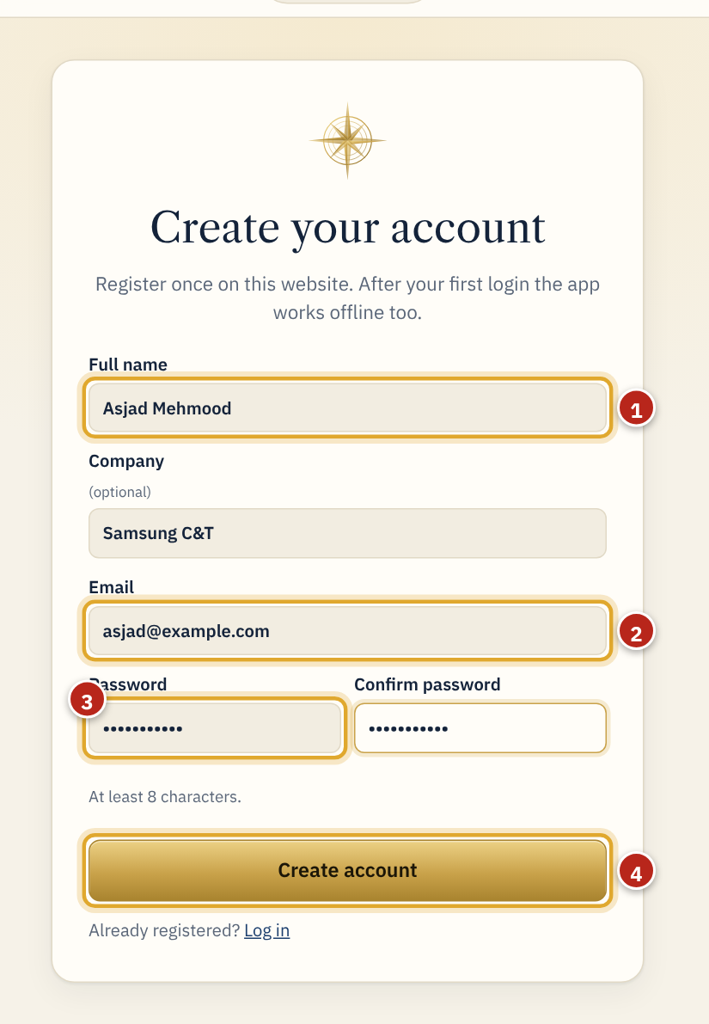
Register
2.1 · YOUR ACCOUNT
Click Register on the front page and fill in the form.
1
Full name. It is printed as the surveyor on your reports. Company is optional.
2
Email address. You log in with it and colleagues share jobs to it.
3
Password (at least 8 characters), typed twice.
4
Click Create account.
Tip. If the site asks you to confirm your email, open the link in the email first, then log in.
Notes:
Register
Click Register on the front page and fill in the form.
1. Full name. It is printed as the surveyor on your reports. Company is optional.
2. Email address. You log in with it and colleagues share jobs to it.
3. Password (at least 8 characters), typed twice.
4. Click Create account.
Tip: If the site asks you to confirm your email, open the link in the email first, then log in.

Slide 8
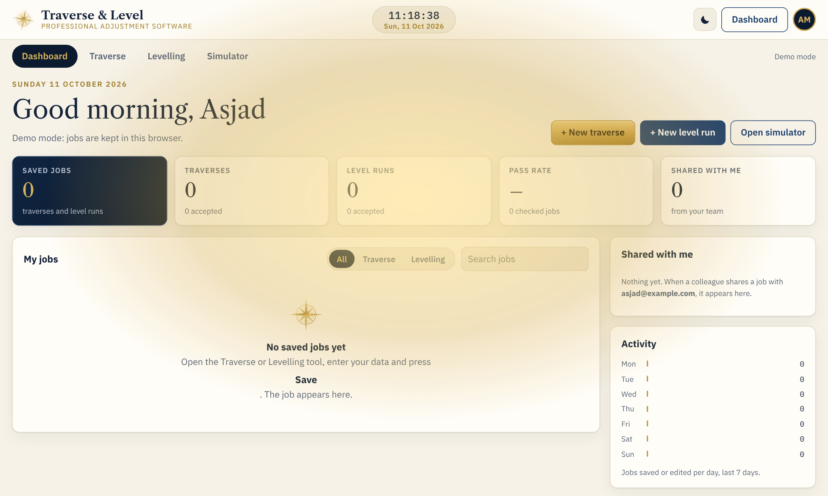
Golden welcome
2.2 · YOUR ACCOUNT
Each time you log in, the screen flashes gold three times and the compass logo shines. Then your dashboard opens.
Notes:
Golden welcome
Each time you log in, the screen flashes gold three times and the compass logo shines. Then your dashboard opens.

Slide 9
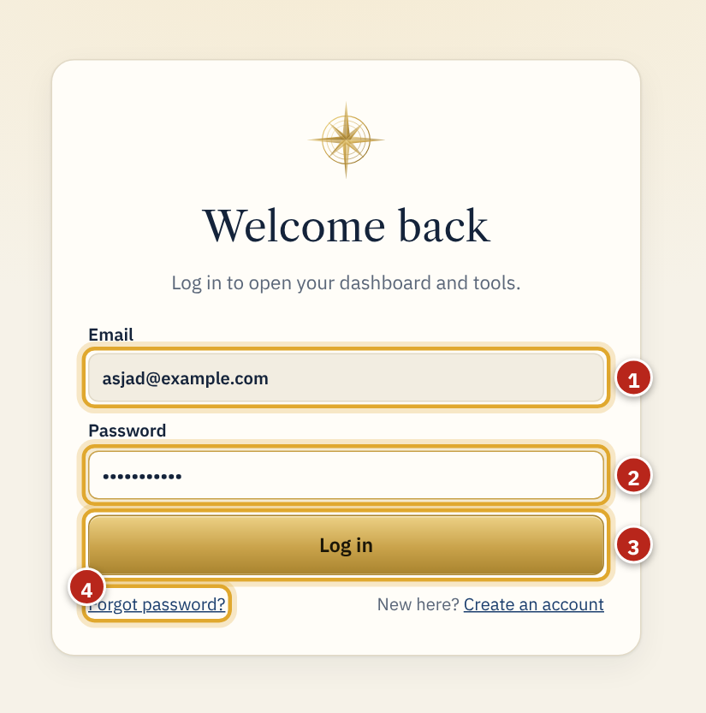
Log in and forgotten password
2.3 · YOUR ACCOUNT
Next time, click Log in on the front page.
1
Your email.
2
Your password.
3
Click Log in.
4
Forgot password? Enter your email and we send a link to set a new password.
Notes:
Log in and forgotten password
Next time, click Log in on the front page.
1. Your email.
2. Your password.
3. Click Log in.
4. Forgot password? Enter your email and we send a link to set a new password.

Slide 10
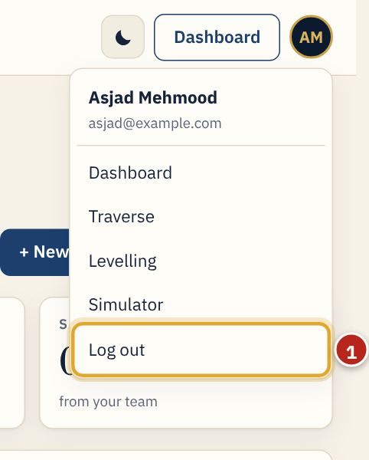
Account menu and log out
2.4 · YOUR ACCOUNT
Click the round button with your initials (top right) to open the account menu.
1
Log out. Any changes saved while offline are uploaded first when there is a connection.
Tip. Do not log out on your own laptop if you need to work offline later: the app opens offline only for the user who is logged in.
Notes:
Account menu and log out
Click the round button with your initials (top right) to open the account menu.
1. Log out. Any changes saved while offline are uploaded first when there is a connection.
Tip: Do not log out on your own laptop if you need to work offline later: the app opens offline only for the user who is logged in.

Slide 11
Dashboard
03
Your home page: every traverse and level run you save is kept here.

Slide 12
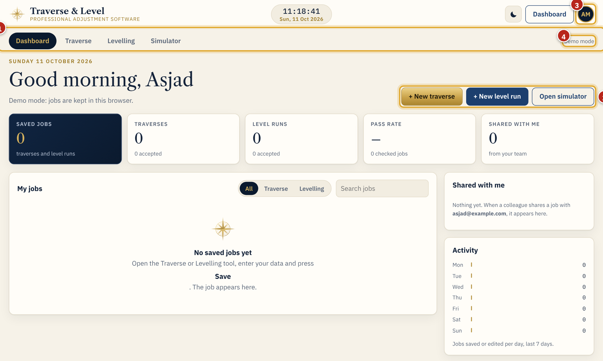
Dashboard at a glance
3.1 · DASHBOARD
After login the dashboard opens with a greeting, today's date and five summary tiles.
1
Section bar: Dashboard, Traverse, Levelling and Simulator.
2
Quick buttons: + New traverse, + New level run, Open simulator.
3
Your account (initials).
4
Connection: Online (saved to your account) or Offline (saving on this device).
Notes:
Dashboard at a glance
After login the dashboard opens with a greeting, today's date and five summary tiles.
1. Section bar: Dashboard, Traverse, Levelling and Simulator.
2. Quick buttons: + New traverse, + New level run, Open simulator.
3. Your account (initials).
4. Connection: Online (saved to your account) or Offline (saving on this device).

Slide 13
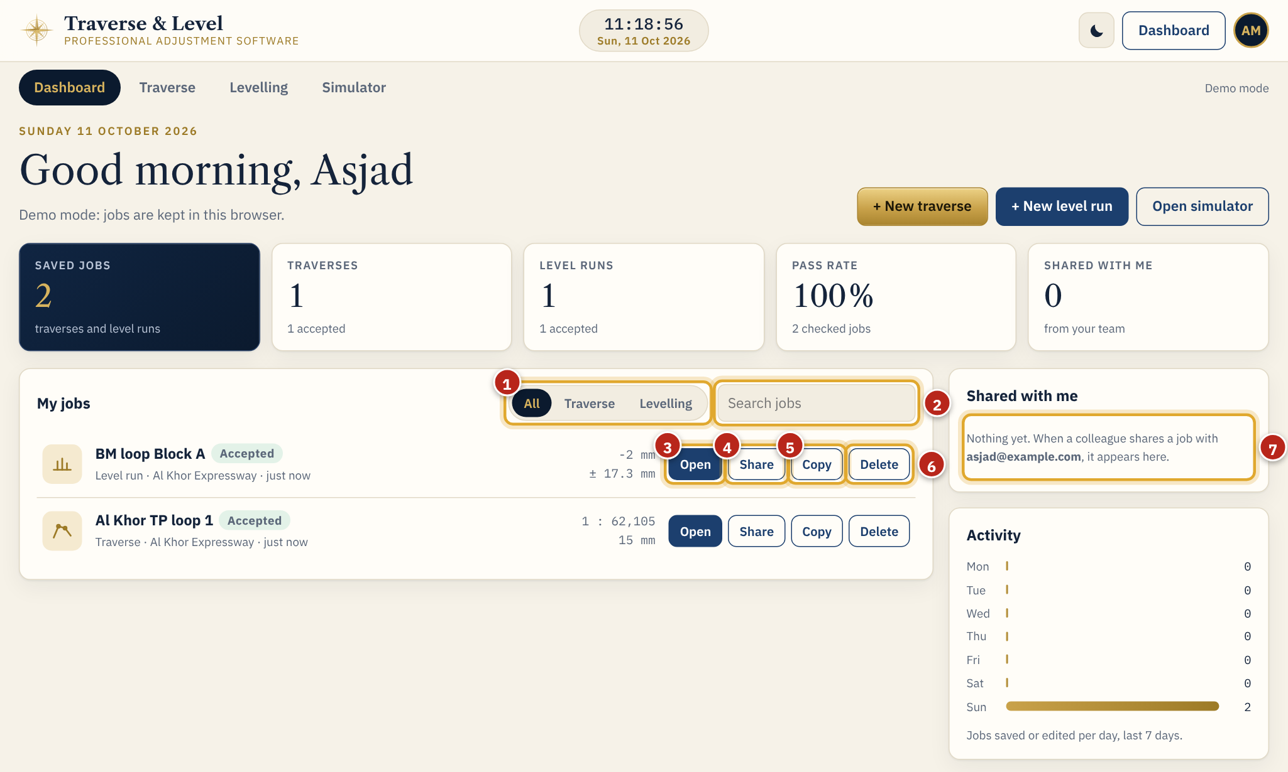
Working with saved jobs
3.2 · DASHBOARD
Each saved job shows its name, type, project, time, status (Accepted, Rejected, Open or Incomplete) and the key result.
1
Filter: All, Traverse or Levelling.
2
Search by job or project name.
3
Open: loads the job into its tool.
4
Share: send the job to a colleague by email.
5
Copy: makes a duplicate you can change.
6
Delete: asks you to confirm first.
7
Shared with me: jobs colleagues have shared with you.
Tip. The Activity chart shows how many jobs you saved or edited on each of the last 7 days.
Notes:
Working with saved jobs
Each saved job shows its name, type, project, time, status (Accepted, Rejected, Open or Incomplete) and the key result.
1. Filter: All, Traverse or Levelling.
2. Search by job or project name.
3. Open: loads the job into its tool.
4. Share: send the job to a colleague by email.
5. Copy: makes a duplicate you can change.
6. Delete: asks you to confirm first.
7. Shared with me: jobs colleagues have shared with you.
Tip: The Activity chart shows how many jobs you saved or edited on each of the last 7 days.

Slide 14
Coordinate traverse
04
Enter the coordinates measured on site, close on a known point, choose the method and read the result.

Slide 15
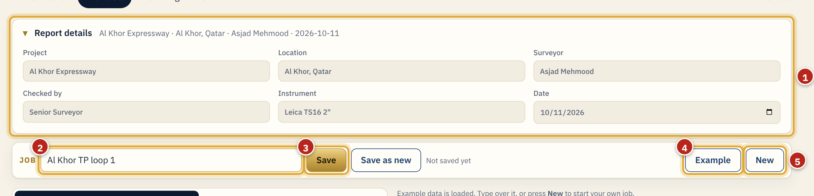
Job name and report details
4.1 · COORDINATE TRAVERSE
Open Traverse from the section bar. Start at the top.
1
Report details: project, location, surveyor, checked by, instrument and date. They print on the PDF report.
2
Job name, for example "Al Khor TP loop 1".
3
Save: stores the job in your dashboard. Save as new keeps the old one and makes another.
4
Example: loads a worked example to try the tool.
5
New: clears the screen for a new traverse (asks to confirm).
Notes:
Job name and report details
Open Traverse from the section bar. Start at the top.
1. Report details: project, location, surveyor, checked by, instrument and date. They print on the PDF report.
2. Job name, for example "Al Khor TP loop 1".
3. Save: stores the job in your dashboard. Save as new keeps the old one and makes another.
4. Example: loads a worked example to try the tool.
5. New: clears the screen for a new traverse (asks to confirm).

Slide 16
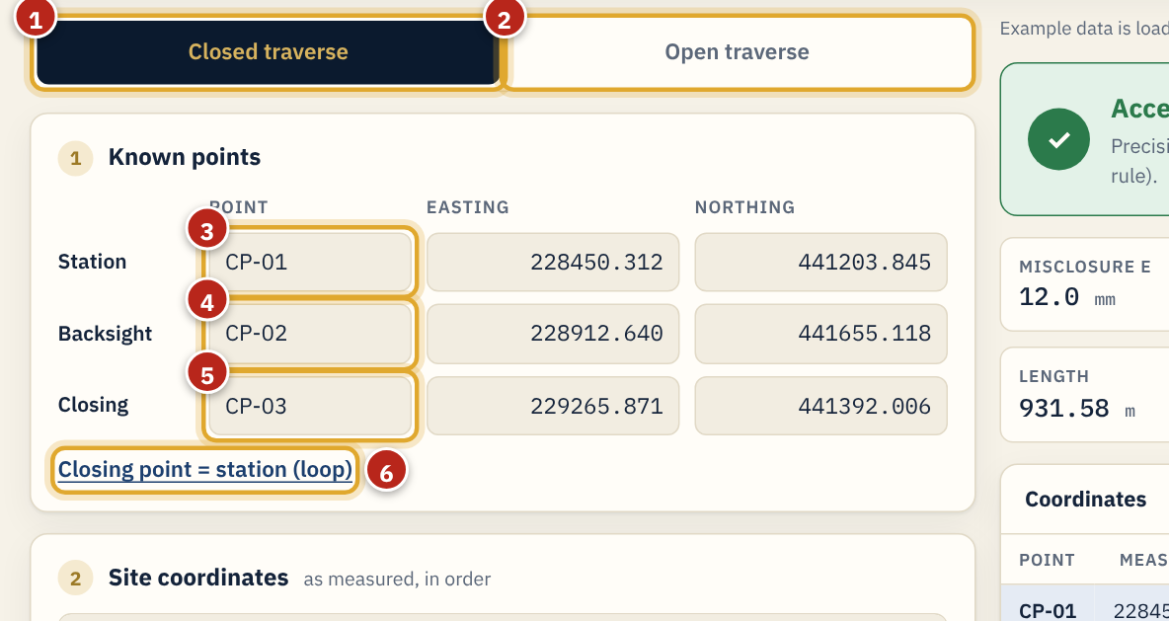
Step 1: known points
4.2 · COORDINATE TRAVERSE
Choose the traverse type, then type the known coordinates.
1
Closed traverse: you finish on a known point, so the error is checked and adjusted.
2
Open traverse: no closing point; coordinates are listed as measured, without a check.
3
Station point: where the instrument starts (name, Easting, Northing).
4
Backsight point: the known reference point you sighted (name, Easting, Northing).
5
Closing point: the known point you finish on, with its known coordinates.
6
For a loop that closes back on the station, click this link to copy the station into the closing point.
Notes:
Step 1: known points
Choose the traverse type, then type the known coordinates.
1. Closed traverse: you finish on a known point, so the error is checked and adjusted.
2. Open traverse: no closing point; coordinates are listed as measured, without a check.
3. Station point: where the instrument starts (name, Easting, Northing).
4. Backsight point: the known reference point you sighted (name, Easting, Northing).
5. Closing point: the known point you finish on, with its known coordinates.
6. For a loop that closes back on the station, click this link to copy the station into the closing point.

Slide 17
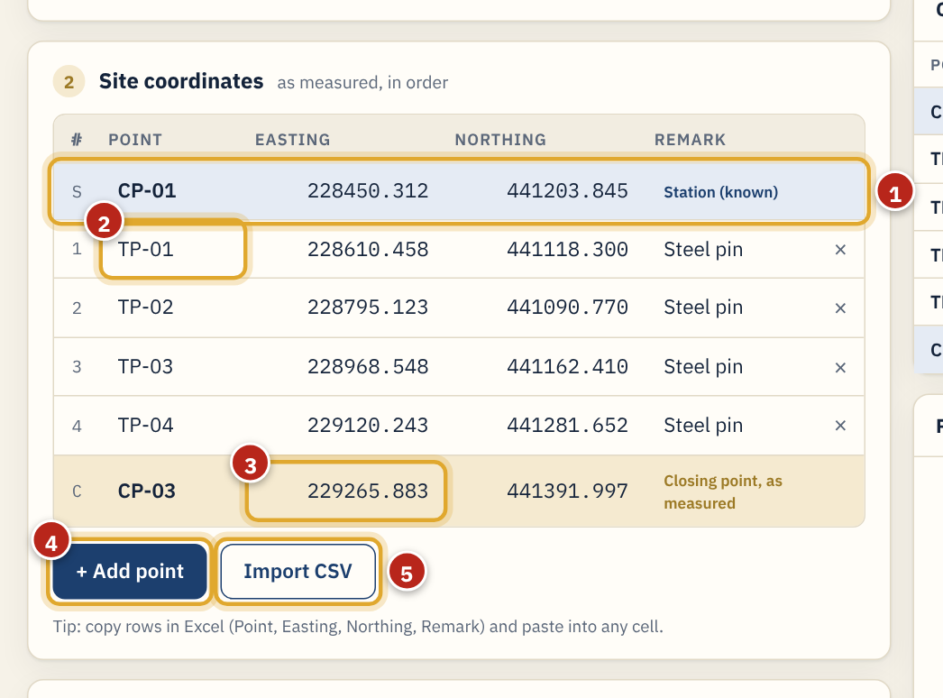
Step 2: site coordinates
4.3 · COORDINATE TRAVERSE
Enter the coordinates measured on site, in the order you observed them.
1
The station row is filled in for you from step 1.
2
Type each traverse point: name, Easting, Northing and a remark. Press Enter to go down a row.
3
Closing point as measured on site (closed traverse only).
4
+ Add point adds a row; × deletes one.
5
Import CSV reads a file with Point, Easting, Northing, Remark.
Tip. Fastest way: copy the rows in Excel (with or without the header) and paste into the first Point cell. All rows fill at once.
Notes:
Step 2: site coordinates
Enter the coordinates measured on site, in the order you observed them.
1. The station row is filled in for you from step 1.
2. Type each traverse point: name, Easting, Northing and a remark. Press Enter to go down a row.
3. Closing point as measured on site (closed traverse only).
4. + Add point adds a row; × deletes one.
5. Import CSV reads a file with Point, Easting, Northing, Remark.
Tip: Fastest way: copy the rows in Excel (with or without the header) and paste into the first Point cell. All rows fill at once.

Slide 18
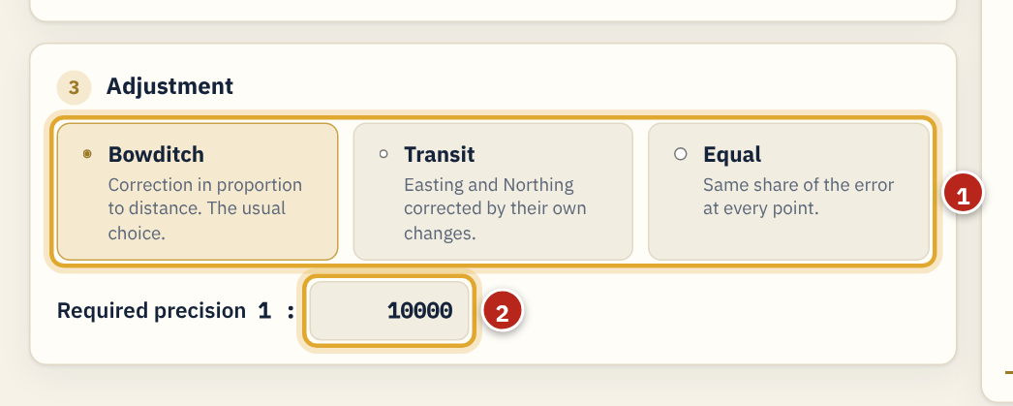
Step 3: adjustment method
4.4 · COORDINATE TRAVERSE
Choose how the misclosure is spread over the points, and the precision you need.
1
Bowditch: correction in proportion to the distance travelled (the usual choice). Transit: Easting and Northing corrected by their own changes. Equal: the same share at every point.
2
Required precision 1 : N, for example 10000 (1 : 10,000) or as your project specification says.
Notes:
Step 3: adjustment method
Choose how the misclosure is spread over the points, and the precision you need.
1. Bowditch: correction in proportion to the distance travelled (the usual choice). Transit: Easting and Northing corrected by their own changes. Equal: the same share at every point.
2. Required precision 1 : N, for example 10000 (1 : 10,000) or as your project specification says.

Slide 19
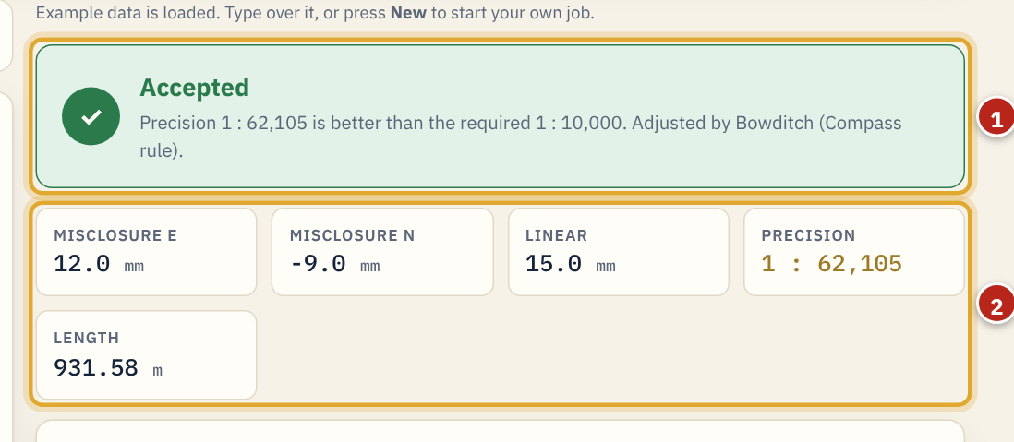
Read the result
4.5 · COORDINATE TRAVERSE
The result updates as you type.
1
Green Accepted: the precision is better than required. Red Rejected: check the field data.
2
Misclosure E and N = measured closing coordinates − known closing coordinates. Linear misclosure = √(E² + N²). Precision = total length ÷ linear misclosure.
Notes:
Read the result
The result updates as you type.
1. Green Accepted: the precision is better than required. Red Rejected: check the field data.
2. Misclosure E and N = measured closing coordinates − known closing coordinates. Linear misclosure = √(E² + N²). Precision = total length ÷ linear misclosure.

Slide 20
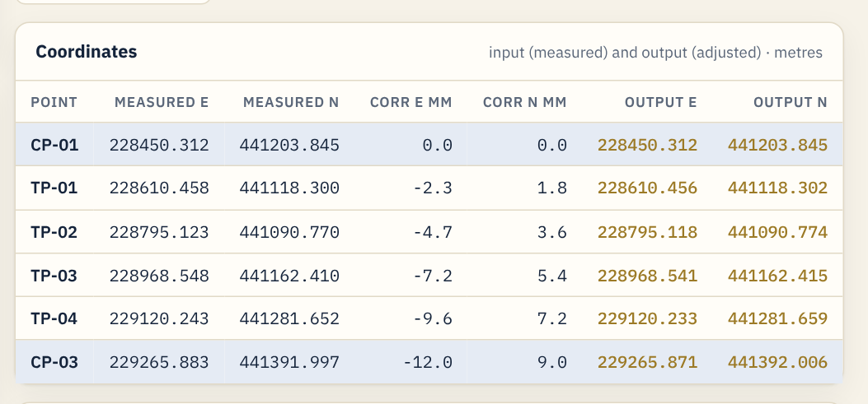
Input and output coordinates
4.6 · COORDINATE TRAVERSE
The coordinates table lists every point: the coordinates you measured, the correction in millimetres, and the adjusted (output) coordinates in gold. The closing point ends exactly on its known coordinates.
Notes:
Input and output coordinates
The coordinates table lists every point: the coordinates you measured, the correction in millimetres, and the adjusted (output) coordinates in gold. The closing point ends exactly on its known coordinates.

Slide 21
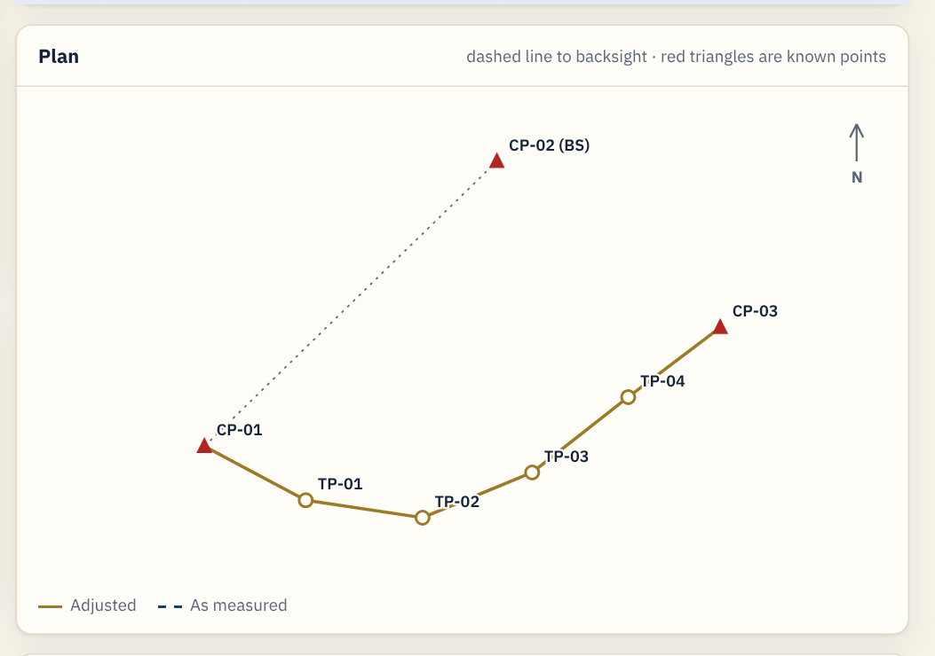
Plan sketch
4.7 · COORDINATE TRAVERSE
The plan shows the adjusted traverse in gold and the measured line dashed. Red triangles are known points; the dotted line goes to the backsight.
Notes:
Plan sketch
The plan shows the adjusted traverse in gold and the measured line dashed. Red triangles are known points; the dotted line goes to the backsight.

Slide 22
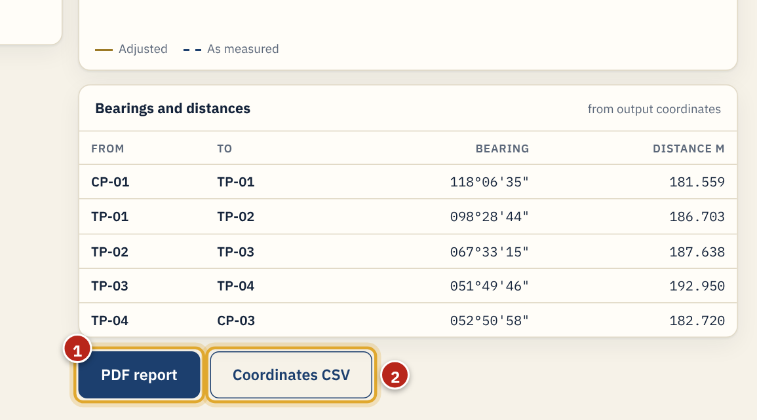
Bearings, PDF report and CSV
4.8 · COORDINATE TRAVERSE
Bearings (whole circle) and distances are computed from the output coordinates.
1
PDF report: details, closure check, input and output coordinates, bearings, sketch and signature boxes.
2
Coordinates CSV: measured, corrections and output coordinates for Excel or CAD.
Notes:
Bearings, PDF report and CSV
Bearings (whole circle) and distances are computed from the output coordinates.
1. PDF report: details, closure check, input and output coordinates, bearings, sketch and signature boxes.
2. Coordinates CSV: measured, corrections and output coordinates for Excel or CAD.

Slide 23
Save the job
4.9 · COORDINATE TRAVERSE
Press Save. The status beside the buttons confirms it.
1
"Saved just now" means the job is in your account. "Unsaved changes" (amber) means you edited it after saving: press Save again.
Notes:
Save the job
Press Save. The status beside the buttons confirms it.
1. "Saved just now" means the job is in your account. "Unsaved changes" (amber) means you edited it after saving: press Save again.

Slide 24
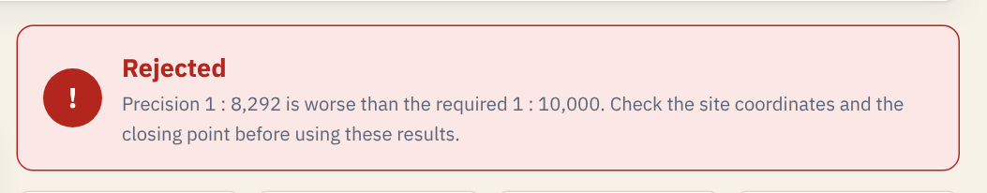
When a traverse is rejected
4.10 · COORDINATE TRAVERSE
Rejected means the precision is worse than required. Check, in this order: the closing point known coordinates, its measured coordinates, then the site coordinates of each point against the field book. Never lower the required precision just to make a traverse pass.
Notes:
When a traverse is rejected
Rejected means the precision is worse than required. Check, in this order: the closing point known coordinates, its measured coordinates, then the site coordinates of each point against the field book. Never lower the required precision just to make a traverse pass.

Slide 25
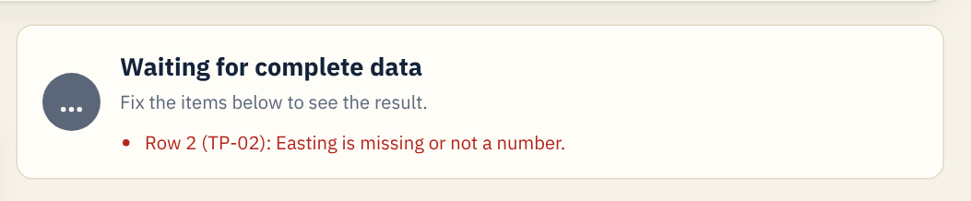
Messages for missing or wrong values
4.11 · COORDINATE TRAVERSE
If a value is missing or not a number, the result waits and lists what to fix, with the row and point name. The cell is outlined in red. Numbers may use a decimal point; thousands commas are allowed (228,450.312).
Notes:
Messages for missing or wrong values
If a value is missing or not a number, the result waits and lists what to fix, with the row and point name. The cell is outlined in red. Numbers may use a decimal point; thousands commas are allowed (228,450.312).

Slide 26
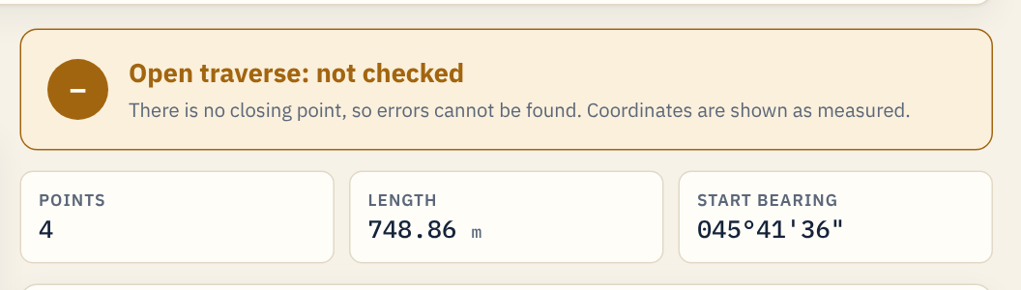
Open traverse
4.12 · COORDINATE TRAVERSE
Choose Open traverse when you cannot close on a known point. The result is shown in amber: coordinates are as measured and no error can be detected. Close the traverse whenever you can.
Notes:
Open traverse
Choose Open traverse when you cannot close on a known point. The result is shown in amber: coordinates are as measured and no error can be detected. Close the traverse whenever you can.

Slide 27
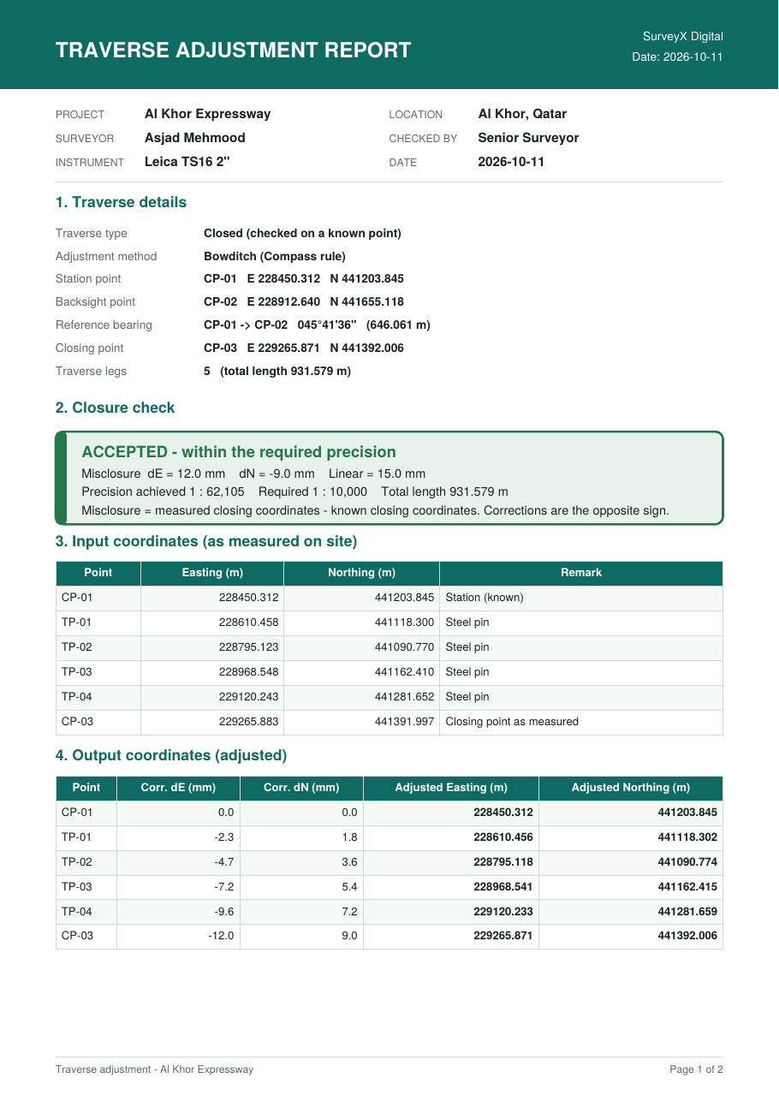
Traverse PDF report
4.13 · COORDINATE TRAVERSE
Page 1 of the report: header with your report details, traverse details, closure check (ACCEPTED / REJECTED), input coordinates and output coordinates. Page 2 has bearings and distances, the sketch and signature boxes for Surveyed by, Checked by and Approved by.
Notes:
Traverse PDF report
Page 1 of the report: header with your report details, traverse details, closure check (ACCEPTED / REJECTED), input coordinates and output coordinates. Page 2 has bearings and distances, the sketch and signature boxes for Surveyed by, Checked by and Approved by.

Slide 28
Levelling
05
Reduce a level book by Rise & Fall or Height of Instrument, check it and adjust it.

Slide 29
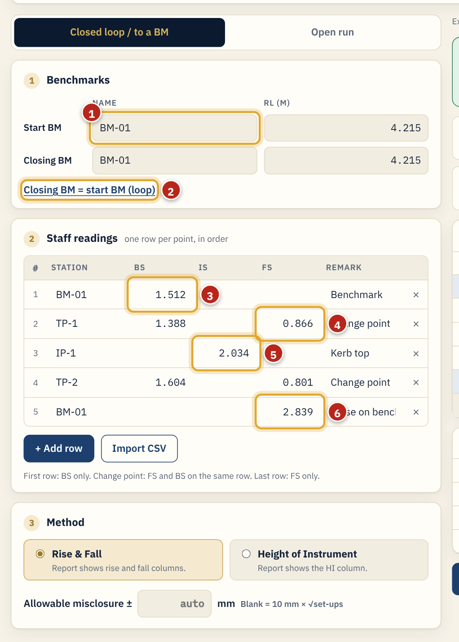
Enter the level book
5.1 · LEVELLING
Open Levelling. Choose Closed loop / to a BM, or Open run. Give the job a name.
1
Start BM: name and known RL. Closing BM: name and known RL.
2
For a loop that closes on the start BM, click this link.
3
First row: the start benchmark with its BS only.
4
Change point: FS and BS on the same row.
5
Intermediate sight: IS only.
6
Last row: the closing benchmark with its FS only.
Tip. Method: Rise & Fall or Height of Instrument (both give the same RLs; the report shows the matching columns). Allowable misclosure: leave blank for 10 mm × √set-ups, or type your own value in mm.
Notes:
Enter the level book
Open Levelling. Choose Closed loop / to a BM, or Open run. Give the job a name.
1. Start BM: name and known RL. Closing BM: name and known RL.
2. For a loop that closes on the start BM, click this link.
3. First row: the start benchmark with its BS only.
4. Change point: FS and BS on the same row.
5. Intermediate sight: IS only.
6. Last row: the closing benchmark with its FS only.
Tip: Method: Rise & Fall or Height of Instrument (both give the same RLs; the report shows the matching columns). Allowable misclosure: leave blank for 10 mm × √set-ups, or type your own value in mm.

Slide 30
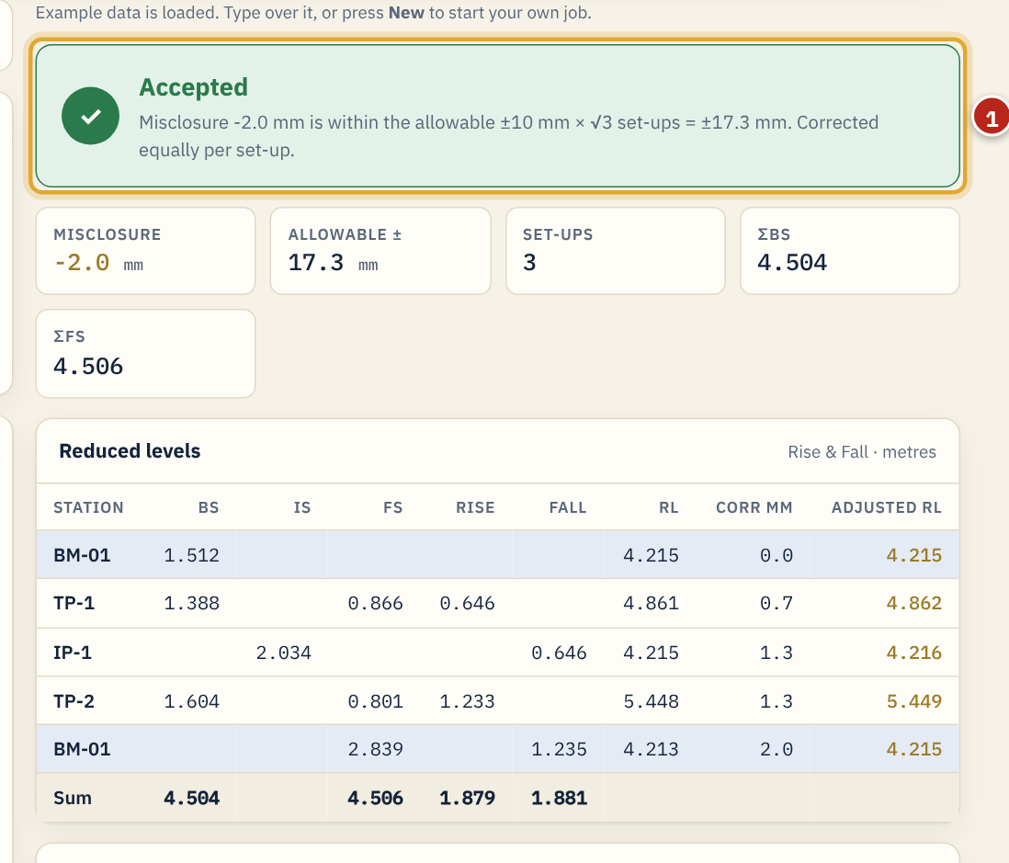
Levelling result
5.2 · LEVELLING
The result shows Accepted or Rejected, the misclosure against the allowable, set-ups, ΣBS and ΣFS.
1
The reduced levels table lists HI or Rise/Fall, RL, the correction (equal per set-up, cumulative) and the adjusted RL. Below it, the arithmetic checks: ΣBS − ΣFS = Last RL − First RL, ΣRise − ΣFall = Last RL − First RL, and HI equals Rise & Fall at every point.
Notes:
Levelling result
The result shows Accepted or Rejected, the misclosure against the allowable, set-ups, ΣBS and ΣFS.
1. The reduced levels table lists HI or Rise/Fall, RL, the correction (equal per set-up, cumulative) and the adjusted RL. Below it, the arithmetic checks: ΣBS − ΣFS = Last RL − First RL, ΣRise − ΣFall = Last RL − First RL, and HI equals Rise & Fall at every point.

Slide 31
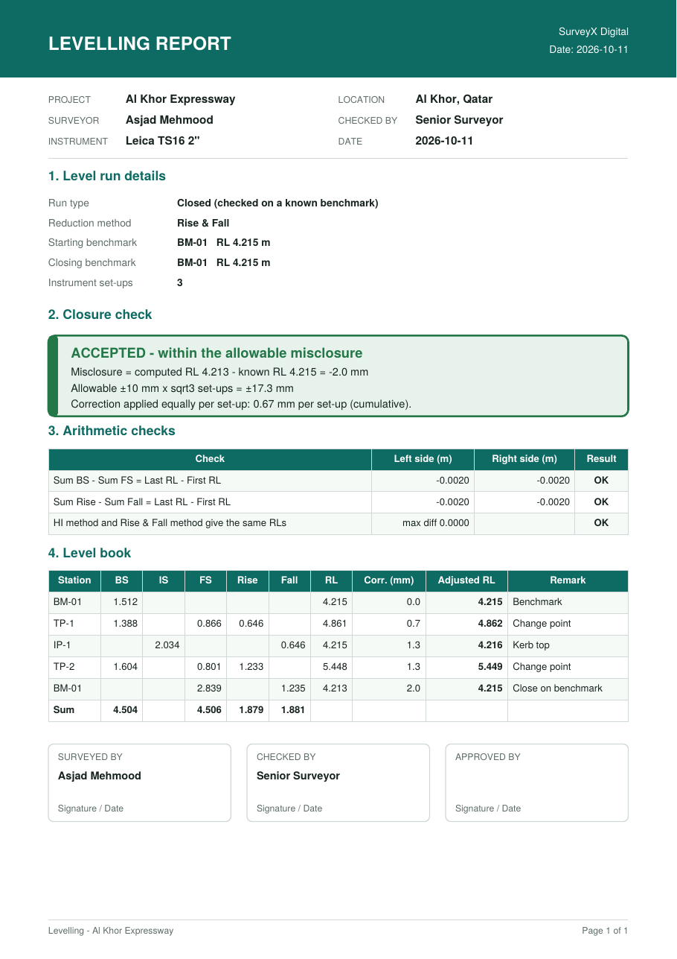
Levelling PDF report
5.3 · LEVELLING
Press PDF report. The report has run details, the closure check, the arithmetic checks, the full level book with adjusted RLs, and signature boxes. Levels CSV saves the table for Excel.
Notes:
Levelling PDF report
Press PDF report. The report has run details, the closure check, the arithmetic checks, the full level book with adjusted RLs, and signature boxes. Levels CSV saves the table for Excel.

Slide 32
Traverse simulator
06
Watch a total station observe a traverse with realistic errors, then adjust it. Ideal for training new surveyors.

Slide 33
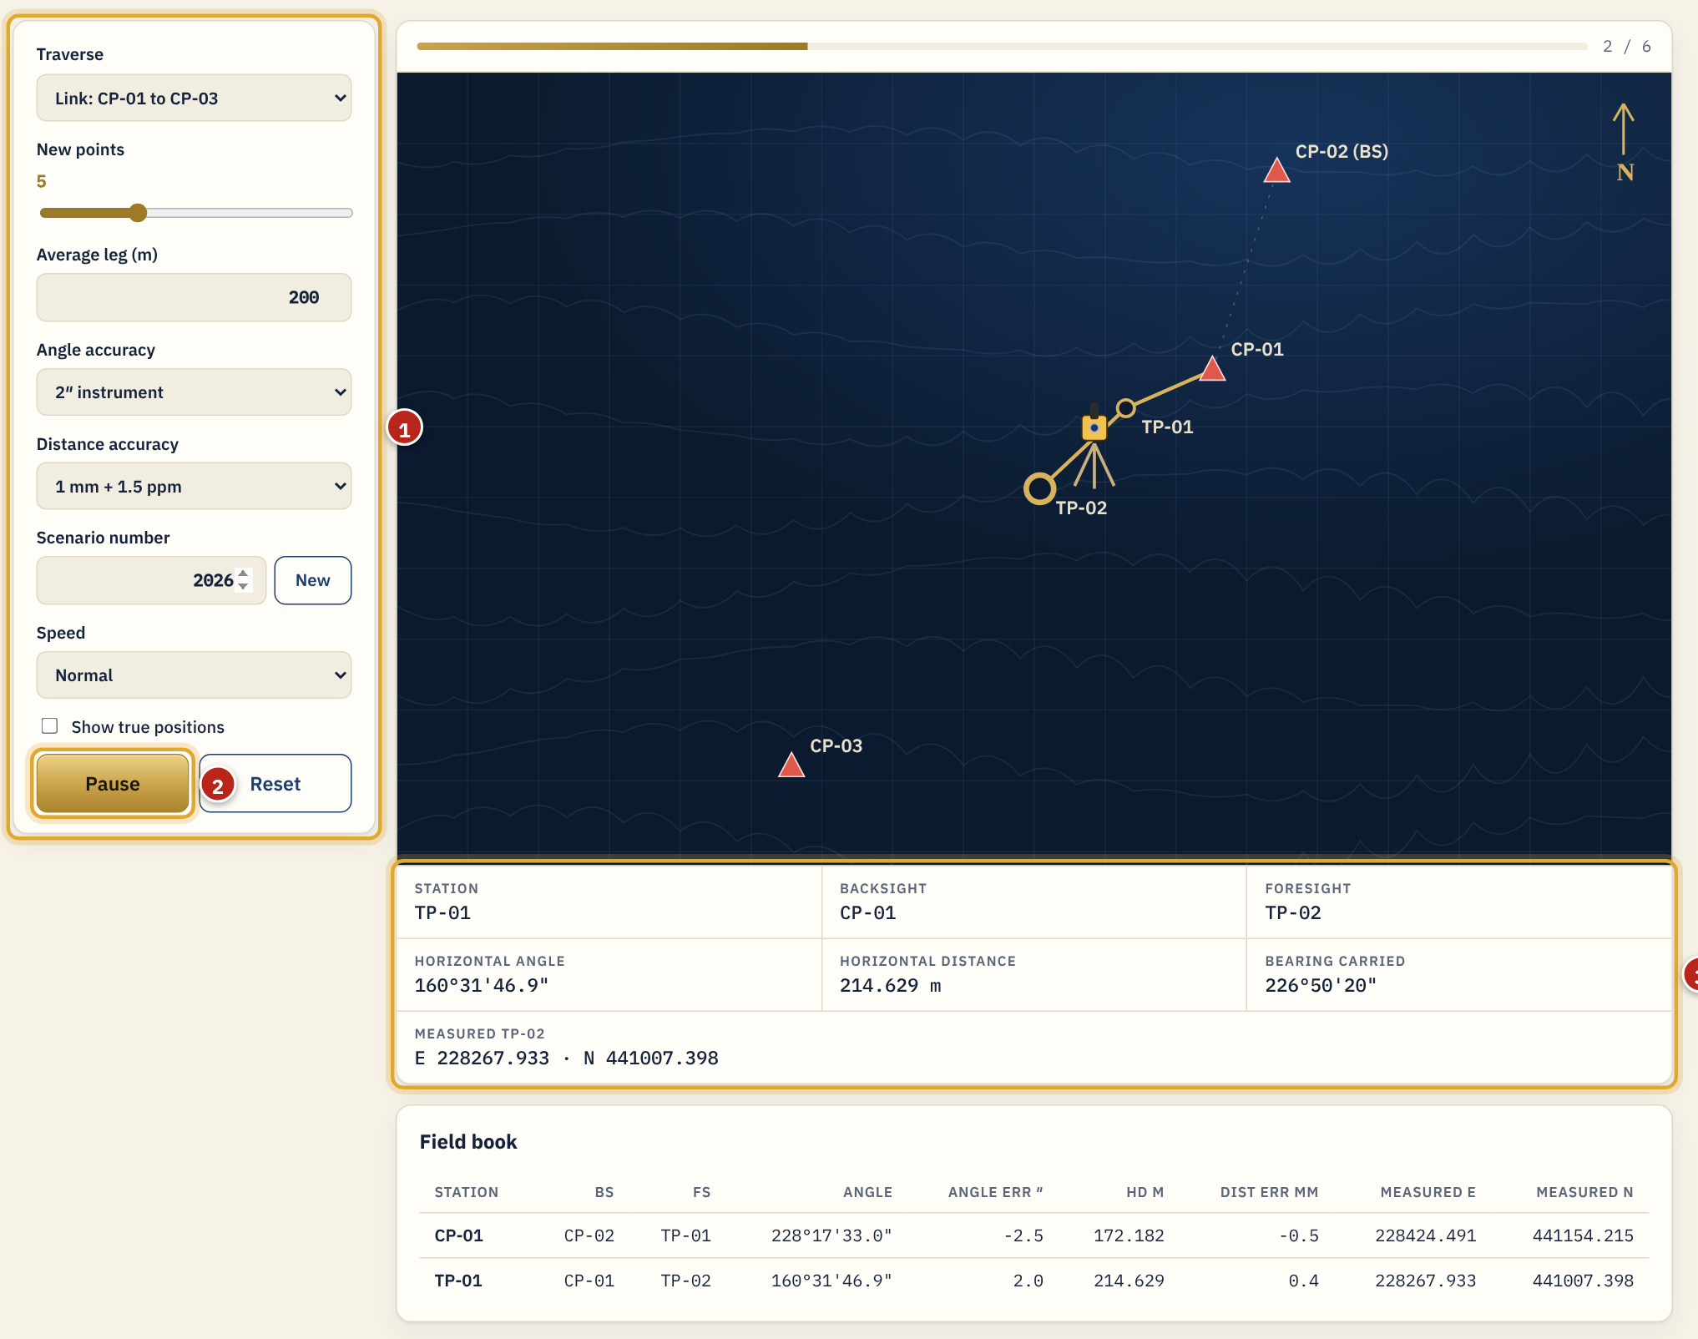
Run a simulation
6.1 · TRAVERSE SIMULATOR
Open Simulator from the section bar.
1
Settings: link (CP-01 to CP-03) or loop, number of new points, average leg, angle accuracy, distance accuracy, scenario number (same number = same traverse), speed, and Show true positions.
2
Run starts the observation. Pause / Resume, and Reset to start again.
3
Live readout: station, backsight, foresight, horizontal angle, distance, bearing carried forward and the measured coordinates.
Notes:
Run a simulation
Open Simulator from the section bar.
1. Settings: link (CP-01 to CP-03) or loop, number of new points, average leg, angle accuracy, distance accuracy, scenario number (same number = same traverse), speed, and Show true positions.
2. Run starts the observation. Pause / Resume, and Reset to start again.
3. Live readout: station, backsight, foresight, horizontal angle, distance, bearing carried forward and the measured coordinates.

Slide 34
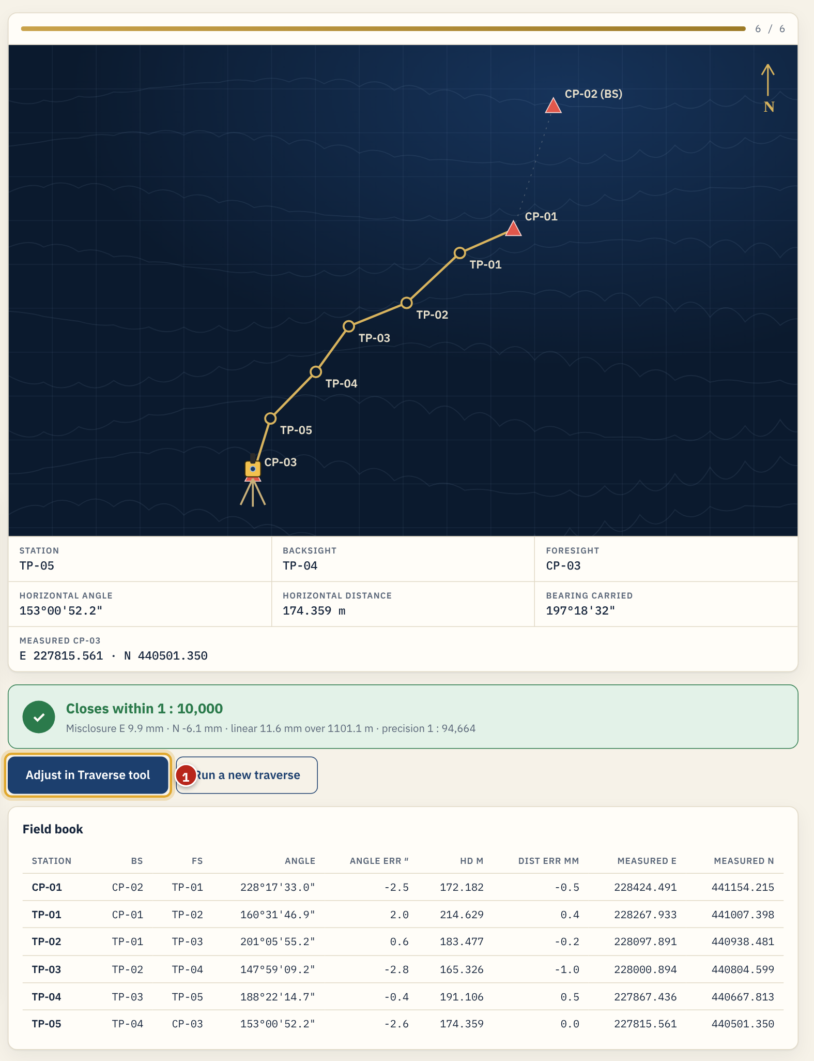
Result and adjustment
6.2 · TRAVERSE SIMULATOR
At the end the simulator shows the misclosure and precision against 1 : 10,000. The field book lists every angle and distance with its random error.
1
Adjust in Traverse tool: loads the simulated site coordinates into the Traverse tool, ready to adjust and save.
Tip. Try a 30″ angle accuracy or "10 mm + 5 ppm" to see how a poor set-up makes a traverse fail.
Notes:
Result and adjustment
At the end the simulator shows the misclosure and precision against 1 : 10,000. The field book lists every angle and distance with its random error.
1. Adjust in Traverse tool: loads the simulated site coordinates into the Traverse tool, ready to adjust and save.
Tip: Try a 30″ angle accuracy or "10 mm + 5 ppm" to see how a poor set-up makes a traverse fail.

Slide 35
Sharing
07
Share a job with a checker, engineer or client. They see it in their own dashboard.

Slide 36
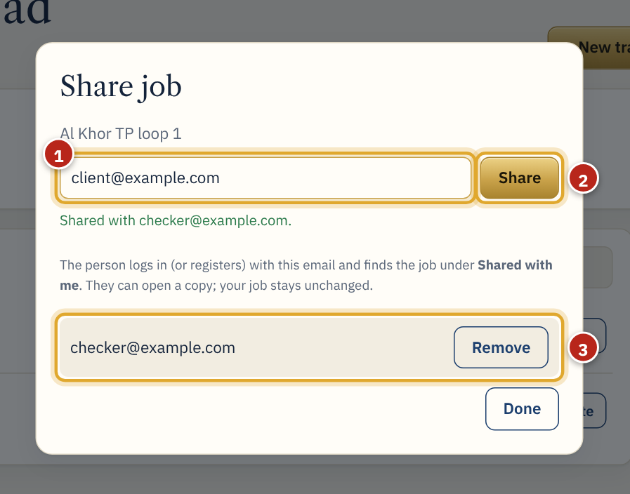
Share a job
7.1 · SHARING
On the dashboard, click Share on the job.
1
Type the person's email.
2
Click Share.
3
People it is shared with. Remove stops sharing.
Tip. The person logs in (or registers) with that same email. Sharing needs an internet connection.
Notes:
Share a job
On the dashboard, click Share on the job.
1. Type the person's email.
2. Click Share.
3. People it is shared with. Remove stops sharing.
Tip: The person logs in (or registers) with that same email. Sharing needs an internet connection.

Slide 37
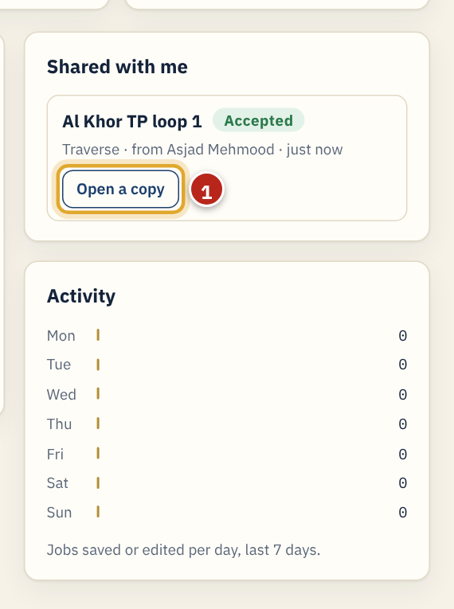
Jobs shared with you
7.2 · SHARING
Jobs that colleagues share with you appear under Shared with me on your dashboard.
1
Open a copy loads it into the tool. Their job stays unchanged; press Save to keep your own copy.
Notes:
Jobs shared with you
Jobs that colleagues share with you appear under Shared with me on your dashboard.
1. Open a copy loads it into the tool. Their job stays unchanged; press Save to keep your own copy.

Slide 38
Offline, dark mode and phone
08
Keep working without internet, at night, or on site from your phone.

Slide 39
Working offline
8.1 · OFFLINE, DARK MODE AND PHONE
After you log in once with internet, the app opens and works on that device without internet.
1
Jobs you save offline show "Saved on this device · will upload when online". They upload by themselves when the connection is back.
Tip. Install it like an app: in Chrome or Edge click the install icon in the address bar; on a phone use "Add to Home screen". The Windows .exe also works offline.
Notes:
Working offline
After you log in once with internet, the app opens and works on that device without internet.
1. Jobs you save offline show "Saved on this device · will upload when online". They upload by themselves when the connection is back.
Tip: Install it like an app: in Chrome or Edge click the install icon in the address bar; on a phone use "Add to Home screen". The Windows .exe also works offline.

Slide 40
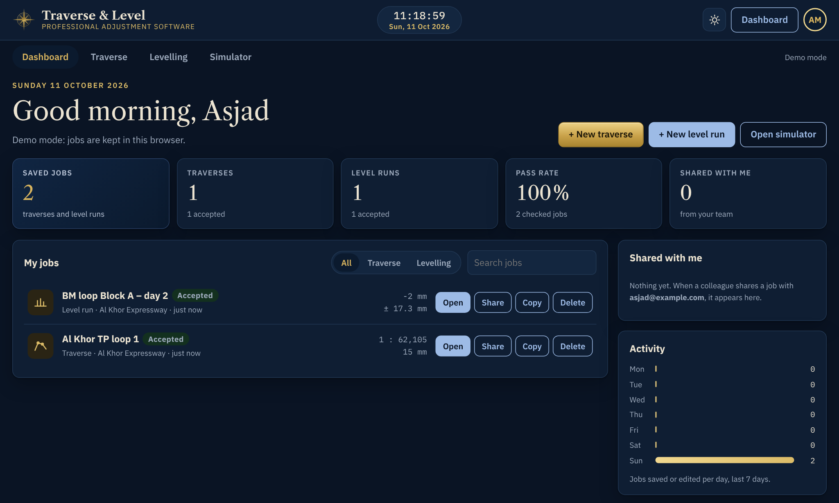
Dark mode
8.2 · OFFLINE, DARK MODE AND PHONE
Click the moon button (top right) for dark mode and the sun button for light mode. Your choice is remembered on that device. The first time, the app follows your computer's setting.
Notes:
Dark mode
Click the moon button (top right) for dark mode and the sun button for light mode. Your choice is remembered on that device. The first time, the app follows your computer's setting.

Slide 41
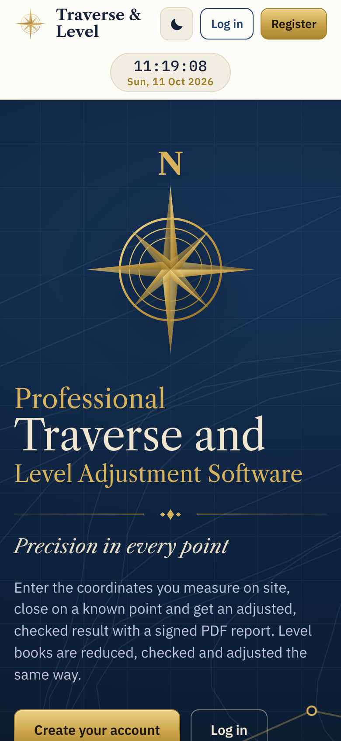
On your phone
8.3 · OFFLINE, DARK MODE AND PHONE
Every screen fits a phone: the clock moves under the logo, and tables scroll sideways inside their own box.
Notes:
On your phone
Every screen fits a phone: the clock moves under the logo, and tables scroll sideways inside their own box.

Slide 42
Sample files
09
Ready-made data that comes with this manual. Practise with it before your own job.

Slide 43
Files included
9.1 · SAMPLE FILES
File | What it is
sample-traverse-site-coordinates.csv | Site coordinates of the example traverse. The comment lines at the top give the known points to type in step 1.
sample-level-book.csv | The example level book (closed loop on BM-01, RL 4.215).
sample-data.xlsx | The same two samples in Excel, formatted as text, ready to copy and paste.
sample-traverse-report.pdf | The PDF report the example traverse produces.
sample-level-report.pdf | The PDF report the example level book produces.

Slide 44
Practise with the samples
9.2 · SAMPLE FILES
Traverse sample
Levelling sample
Open Traverse and press New.
Type the known points from the top of the CSV: CP-01 station, CP-02 backsight, CP-03 closing.
Import CSV: sample-traverse-site-coordinates.csv (or paste from sample-data.xlsx).
Closing point measured: E 229265.883, N 441391.997.
Result: Accepted, precision 1 : 62,105.
Open Levelling and press New.
Start BM: BM-01, RL 4.215. Click "Closing BM = start BM (loop)".
Import CSV: sample-level-book.csv.
Result: Accepted, misclosure −2.0 mm, allowable ±17.3 mm.

Slide 45
Troubleshooting
10
Messages you may see and what to do about them.

Slide 46
Messages in the tools
10.1 · TROUBLESHOOTING
You see | What to do
Waiting for complete data | A value is missing or not a number. Read the red list: it names the row and point. Fix the outlined cell.
Rejected | Precision is worse than required. Check the closing point known and measured coordinates, then each point against the field book.
Transit rule cannot spread an error | All legs run exactly north–south or east–west. Choose Bowditch.
Level book: change point needs both FS and BS | Put the FS and the next BS on the same row.
Email or password is not correct | Check the email spelling and Caps Lock, or use Forgot password.

Slide 47
Account, offline and desktop
10.2 · TROUBLESHOOTING
You see | What to do
Please confirm your email first | Open the confirmation link in your email, then log in.
Opens offline but my jobs from another device are missing | Jobs come down from your account when you are online. Connect once and they appear.
Not uploaded label on a job | It was saved offline. It uploads automatically when you are online; do not log out before that.
Windows protected your PC (the .exe) | Click More info, then Run anyway. The program is not code-signed yet.
The .exe opens a blank window | Install Microsoft Edge WebView2 Runtime (free from Microsoft), then open it again.

Slide 48
Going live
A
For the administrator: switch the website from demo mode to real accounts (about 20 minutes, free Supabase plan).

Slide 49
Connect the account service
A.1 · GOING LIVE
1
Create the account service
Go to supabase.com, sign up free and create a project (choose a region near Qatar, for example Middle East or Europe).
2
Create the tables
In the project, open SQL Editor → New query, paste the whole file supabase/schema.sql and click Run. This creates the jobs and sharing tables with security rules: each user sees only their own jobs and jobs shared with their email.
3
Copy the two keys
Project Settings → API: copy the Project URL and the anon public key.
4
Fill in config.js
Open website/config.js in Notepad and paste the URL and key, and your website address as siteUrl. Save.

Slide 50
Publish and test
A.2 · GOING LIVE
5
Set the website address in Supabase
Authentication → URL Configuration: set Site URL to your website address and add it under Redirect URLs. Under Authentication → Providers → Email you can turn "Confirm email" on (safer) or off (instant access).
6
Publish the website
Upload everything inside the website folder to your host: Netlify (drag the folder onto app.netlify.com/drop), Vercel, GitHub Pages or your cPanel public_html. Use https so the app can install and work offline.
7
Test
Open the website, register, save a job, log in on a second device and check the job is there. The "Demo mode" bar disappears once the keys are in.
8
Desktop .exe
The .exe contains its own copy of config.js. After step 4, rebuild it (see desktop/README.md: one command) or send the URL and anon key to be rebuilt. Until then the .exe runs in demo mode with accounts kept on that PC.

Slide 51
Precision in every point
Professional Traverse and Level Adjustment Software · SurveyX Digital

